Slide 1





Albert Gordo
Lluís Gómez
1

Slide 2
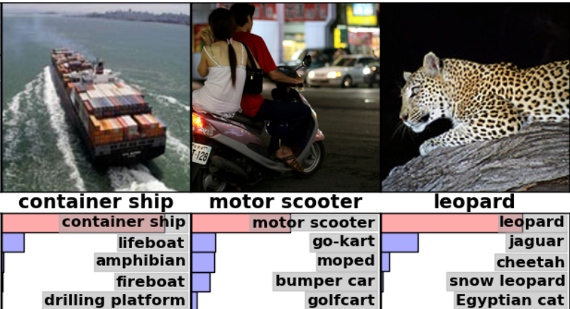
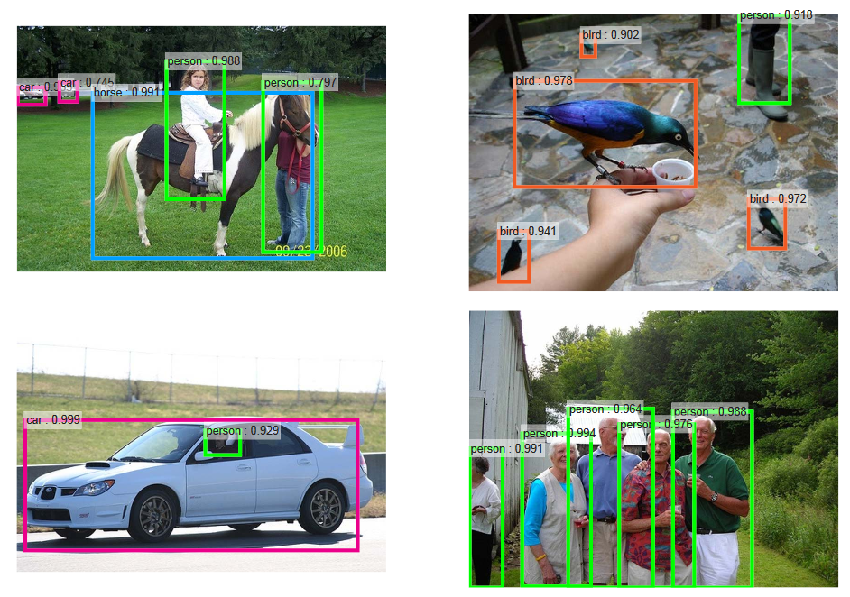
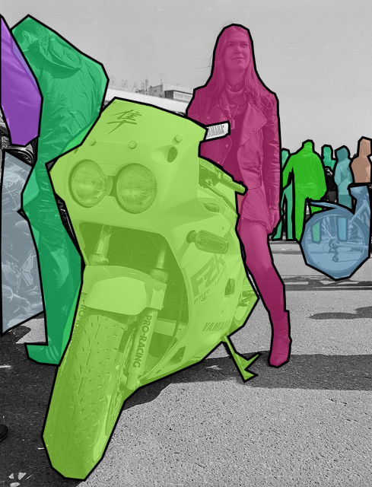
Motivation
Huge advances in computer vision in the last few years:
ILSVRC Recognition Challenge:
2011: 26% error
2015: 3.57% error (absolute error reduced by 22.4 points)
Pascal VOC07 object detection:
2012: ~35% mAP
2015: 73% mAP (mAP doubled)
Pascal segmentation:
2012: ~40% AP
2015: ~77% AP (AP almost doubled)
2

Slide 3
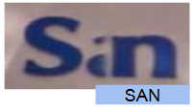
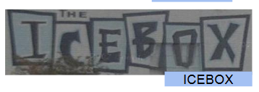


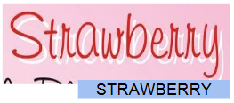
Motivation
Large improvements in scene-text:
Text spotting:
SVT-50: 38% (2011) to 76% (2015)
IC03-50: 68% (2011) to 90% (2015)
Text recognition with lexicon:
SVT-50: 73% (2012) to 96.5% (2015)
IIIT5k-1000: 57.5% (2012) to 94.5% (2015)
IC03-50: 82% (2012) to 99% (2015)
Text recognition without lexicon (2015):
SVT: 81%
IIIT5K: 78.2%
IC03: 89.4%
Lee and Osindero 2016
3

Slide 4
Motivation
Are the techniques for scene-text and document-text similar?
Unsurprisingly, yes!
Hottest techniques in scene text recognition have been used in handwritten-text recognition for years! (E.g. recurrent neural networks [Frinken’11], attention models [Fukushima’92], automatic image rectification [Espana-Boquera’11], etc)
4

Slide 5
Motivation
Do techniques from scene-text transfer to document-text?
In many cases, yes!
Most problems in scene-text recognition and in document-text recognition are the same or extremely similar. Few works leverage the particularities of each domain.
5

Slide 6
Objectives
The goals of this tutorial are as follows:
To introduce the attendees to the problems of text localization, text recognition, and text understanding in natural images, highlighting the similarities and differences between them and the same tasks performed on document images.
To provide a brief historical overview of the main approaches used to address these problems.
To discuss the current state-of-the-art techniques to address these problems, and how some of these techniques can be leveraged in the document analysis domain.
To provide the attendees with open-source tools, code, and models to easily replicate some of the state-of-the-art results and to adapt them to document analysis tasks.
6

Slide 7
Agenda
Introduction [10:00 – 10:10]
Scene-text Localization [10:10 – 10:55]
Theoretical introduction
Practical
Scene-text Recognition [10:55 – 11:40]
Theoretical introduction
Practical
Coffe break [11:40 – 12:00]
Scene-text Understanding [12:00 – 12:40]
Theoretical introduction
Practical
Closing Remarks [ 12:40 – 12:50]
Discussion [ 12:50 – 13:00]
7

